Slide 1

IOWA ACTIVITIES DIRECTOR
To insert your company logo on this slide
From the Insert Menu
Select “Picture”
Locate your logo file
Click OK
To resize the logo
Click anywhere inside the logo. The boxes that appear outside the logo are known as “resize handles.”
Use these to resize the object.
If you hold down the shift key before using the resize handles, you will maintain the proportions of the object you wish to resize.
MENTOR LEADERSHIP PROGRAM
NEW AD Workshop II 2026
Professional Development
Notes:
PERRY STUDENT ACTIVITIES ADVISORY COUNCIL
07/16/96
*tom.lipovac@perry.k12.ia.us
##

Slide 2

IOWA ACTIVITIES DIRECTOR MENTOR LEADERSHIP PROGRAM
“Engage, educate, equip, encourage, empower, energize, and elevate. Those are the methods for maximizing the potential of any individual, team, organization, or institution for ultimate success and significance. Those are the methods of a mentor leader. Remember that mentor leadership is all about serving.” Tony Dungy
“
Notes:
TL

Slide 3
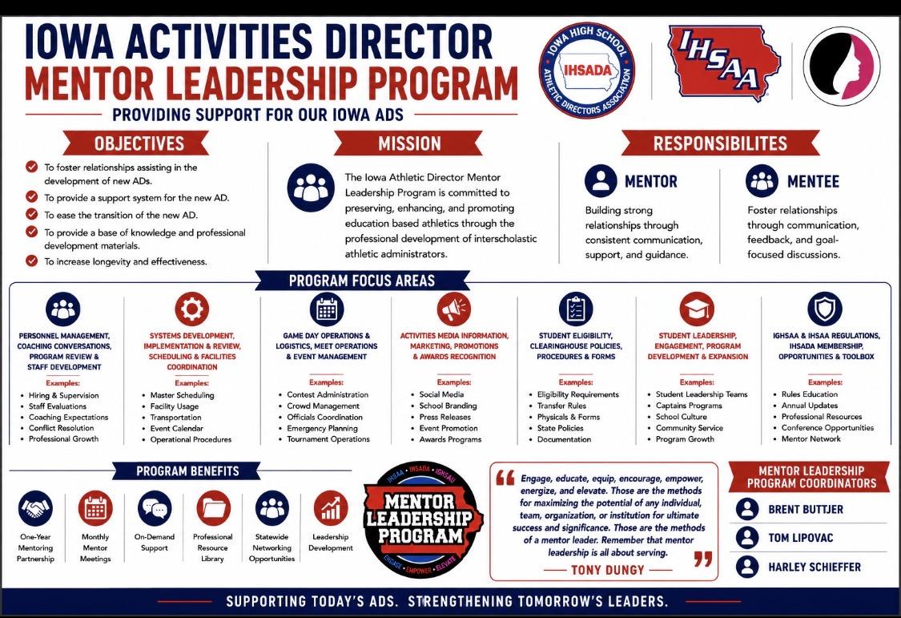
MENTOR LEADERSHIP PROGRAM OVERVIEW
Notes:
TL

Slide 4
IOWA ACTIVITIES DIRECTOR MENTOR LEADERSHIP Professional Development Resources
Mentor Leadership Program
IHSADA Toolbox
New AD Workshop I (August)
IHSADA District Meeting (October)
New AD Workshop II (November)
IHSADA Evaluator Training (November)
NIAAA National Convention (December)
NIAAA LTI Classes & Webinars
IHSADA State Convention (Spring)
Notes:
TL

Slide 5

IHSADA
Mentor Leadership Program
IHSADA EVALUATOR TRAINING I OVERVIEW
The IHSADA Evaluator Approval I introduces the National Standards for Sports Coaches and Core Responsibilities as a common language and as an incorporated process encompassing the interview, pre-season conversations, in-season conversations and observations, program review and self-reflection, and formative and summative evaluations.
“We must get our players to believe that the best way to improve the team is to improve themselves, and in so doing, we must not lose sight of the fact that the same principle holds true in regards to the coach.” John Wooden

Slide 6
IHSADA
Mentor Leadership Program
IHSADA EVALUATOR TRAINING I COURSE
LTC Course 707: Assessment of Interscholastic Athletic Programs and Personnel
LTC Course 723: Administration of Professional Growth Programs For Interscholastic Athletic Personnel
IHSADA Workshop: Examination of the National Standards for Sport Coaches (NSSC) & Core Responsibilities.
Final Project: The submission of a Formal Evaluation Tool that incorporates the National Standards for Sport Coaches (NSSC) & Coaching Core Responsibilities.
“Success is peace of mind that is a direct result of self-satisfaction in knowing that you made the effort to become the best you are capable of becoming.” John Wooden

Slide 7


Slide 8


IHSADA STATE CONVENTION
NIAAA LTI Courses
Mentor Leadership Program Meeting
IGHSAU & IHSAA Updates
Keynote Speaker
General Sessions
Mini-Sessions
District & Cracker Barrel Sessions
Awards Programs: Hall of Fame, HS & MS ADOY, Years of Service
Vendor Hall
Networking & Relationship Building Opportunities
Notes:
BB

Slide 9

THE NATIONAL INTERSCHOLASTIC ATHLETIC ADMINISTRATORS ASSOCIATION (NIAAA) Parent Group of the IHSADA
Professional Development For Athletic Administrators
  Leadership Training Institute (LTI)
  Athletic Administrators take LTI courses to gain different certification levels. (RAA/RMAA/CAA/CMAA)
  Leadership Courses focusing on current issues.
    Foundation Courses (500)
    Operations Management (600)
    Leadership Courses (700)

Slide 10

IHSADA
Mentor Leadership Program
THE NATIONAL FEDERATION OF HIGH SCHOOLS (NFHS) Parent Group of the IGHSAU & IHSAA
NFHS LEARN
The NFHS Learning Center (NFHSLearn.com), offers educational resources for high school sports and performing arts participants.
Starting with two courses, the platform now provides over 90 courses, including topics on coaching, first aid, officiating, and sportsmanship.
NFHS course completions are applicable for Coaching Authorization renewal.
The site also administers the National Credentials Program.
Notes:
HS

Slide 11
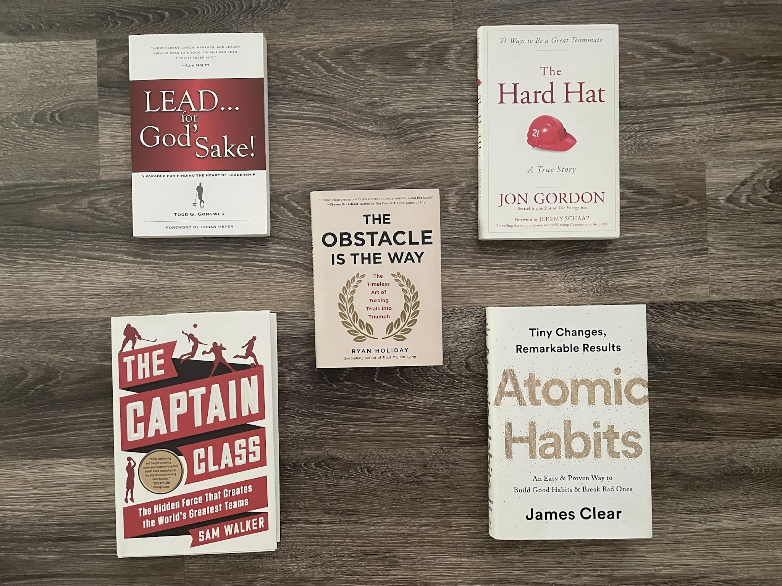
IHSADA
Mentor Leadership Program
“LEADERS ARE READERS” Harry Truman
Notes:
TL

Slide 12

IHSADA
Mentor Leadership Program
THE SLIGHT EDGE: Jeff Olson
“The simple things that lead to success are all easy to do. But they're also just as easy not to do.”
“The truth is, what you do matters. What you do today matters. What you do every day matters. Successful people just do the things that seem to make no difference in the act of doing them and they do them over and over and over until the compound effect kicks in.”
Notes:
TL

Slide 13
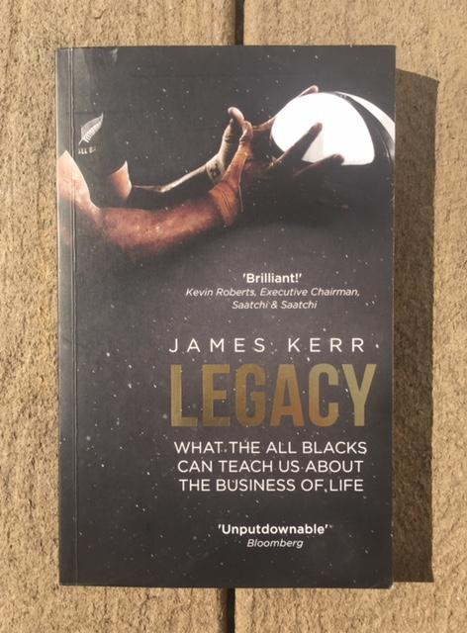

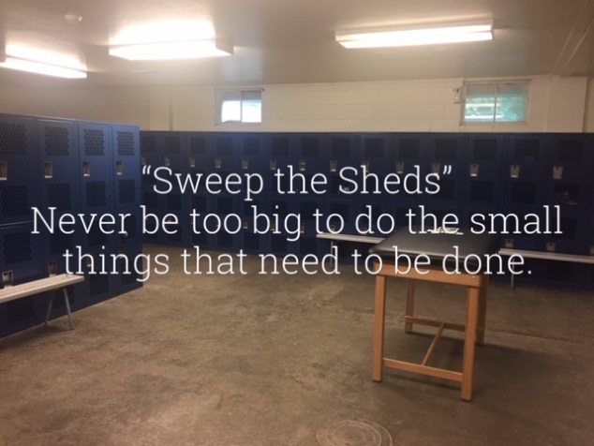
IHSADA
Mentor Leadership Program
LEGACY: James Kerr
Notes:
TL

Slide 14
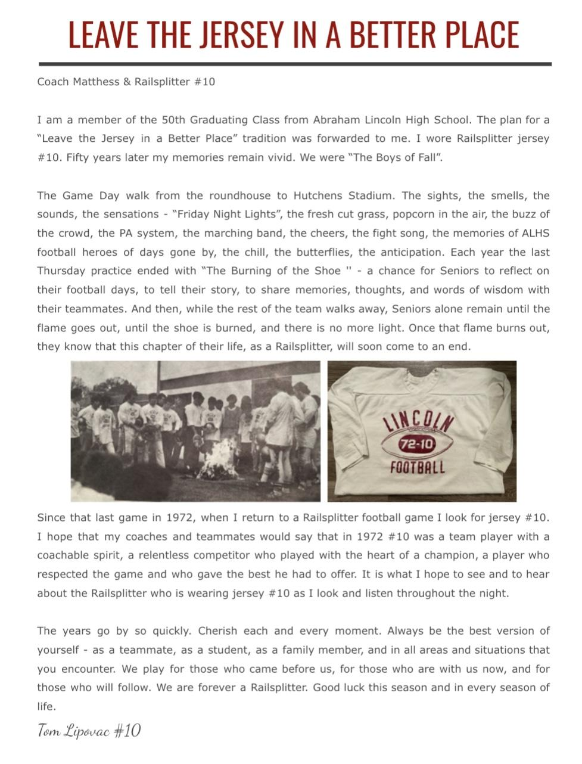
IHSADA
Mentor Leadership Program
“WHAT WILL BE YOUR LEGACY?”
“We stand on the shoulders of those who have gone before us. What will we create for those who come after us?” Alan Seale
“There’s a saying in the team. ‘You don’t own the jersey, you’re just the body in the jersey at the time.’ It’s your job to continue the legacy and add to it when you get the opportunity. The current All Blacks team is playing for the guys that have played in the jersey before. They also play for All Blacks yet to be born. Leave the jersey in a better place.” James Kerr
Notes:
TL

Slide 15
IHSADA
Mentor Leadership Program
IOWA ACTIVITIES DIRECTOR
MENTOR LEADERSHIP TEAM 2026-2027
Jim Boehmer Jeff Cook Judge Johnston
Randy McDonald Merle Olberding Dave Wiebers
Roger Wright
Notes:
HS

Slide 16

IHSADA
Mentor Leadership Program
IOWA ACTIVITIES DIRECTORS
MENTOR-MENTEE PROGRAM REVIEW
Serve, Suggest, Support, Strategies, & Systems connecting with the new Activities Director.
  Successes:
    What went well?
    What was most useful?
  Challenges:
    What did we learn?
    What do we need?
  Recommendations:
    What can be done better?
    What support will be helpful?
"An organization can only become the-best-version-of-itself to the extent that the people who drive that organization are striving to become better-versions-of-themselves". Matthew Kelly
Notes:
BB

